Slide 1
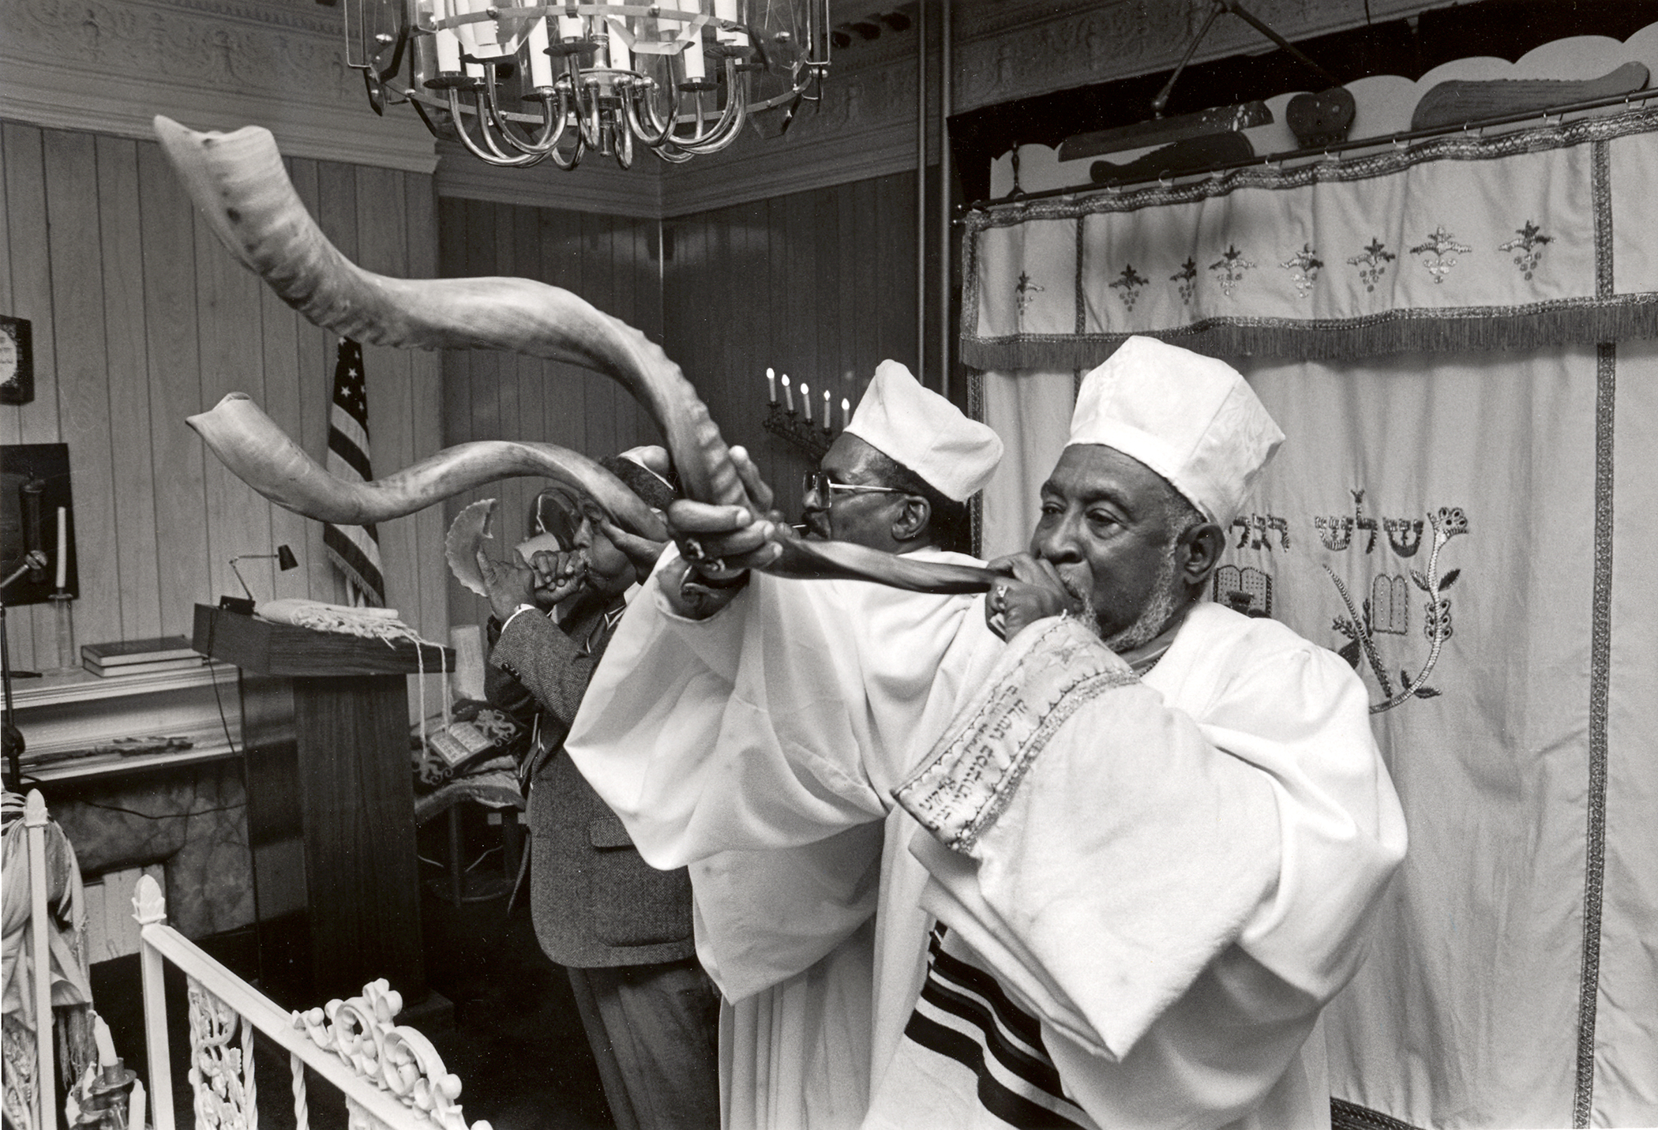
Blow Ye The Trumpet in Zion: The Music of Black Jews
Historical Analysis Pictorial Overview Open Discussion
© Chester Higgins
Rabbi Sholomo Ben Levy
African American Museum
May 14, 2026

Slide 2
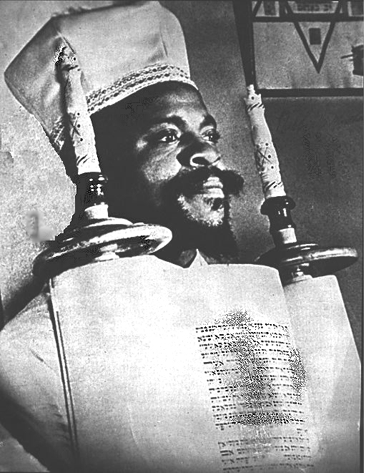
Rabbi W. A Matthew, Builder
Lived, 1892-1973
Founded Commandment Keepers E. H. Cong. Harlem, 1919
Rabbinical College 1925
Community Leader / Activist

Slide 3
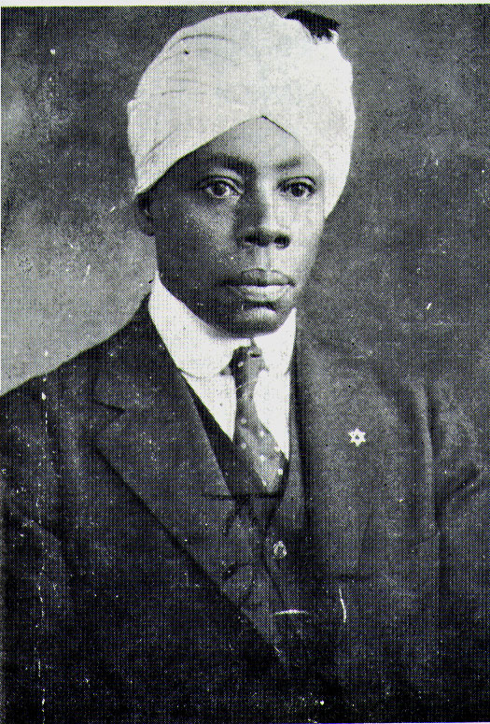
Rabbi Arnold J. Ford, Founder
Lived, 1877-1935
Musical Director of the Universal Negro Improvement Association (wrote anthem)
Founded Beth B’nai Abraham, 1923
Immigrated to Ethiopia in 1930
Ordained Rabbi Matthew

Slide 4
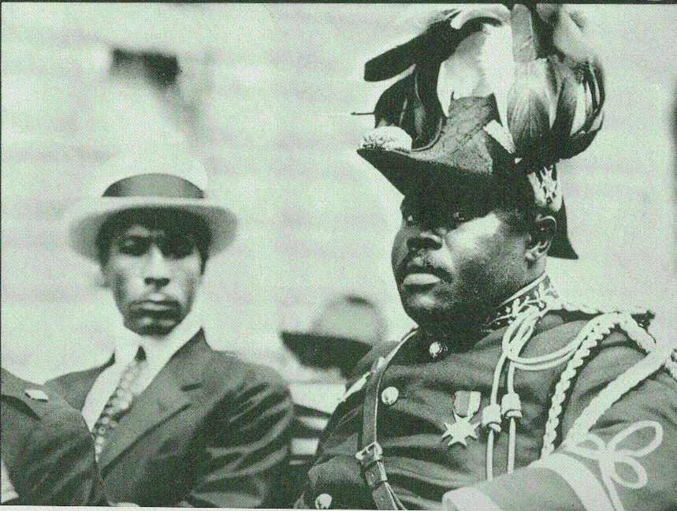
Marcus Mosiah Garvey
Lived 1887-1940
1914, Organized the Universal Negro Improvement Association in Jamaica
1917, Opened a UNIA branch in Harlem
1918-1924 Negro World, Black Star Line, Black Cross Nurses, etc.
1924 Officially proclaimed the blackness of Jesus
1925-1927 Federal Prison in Atlanta
1927 Returned to Jamaica
1940 Died in England

Slide 5
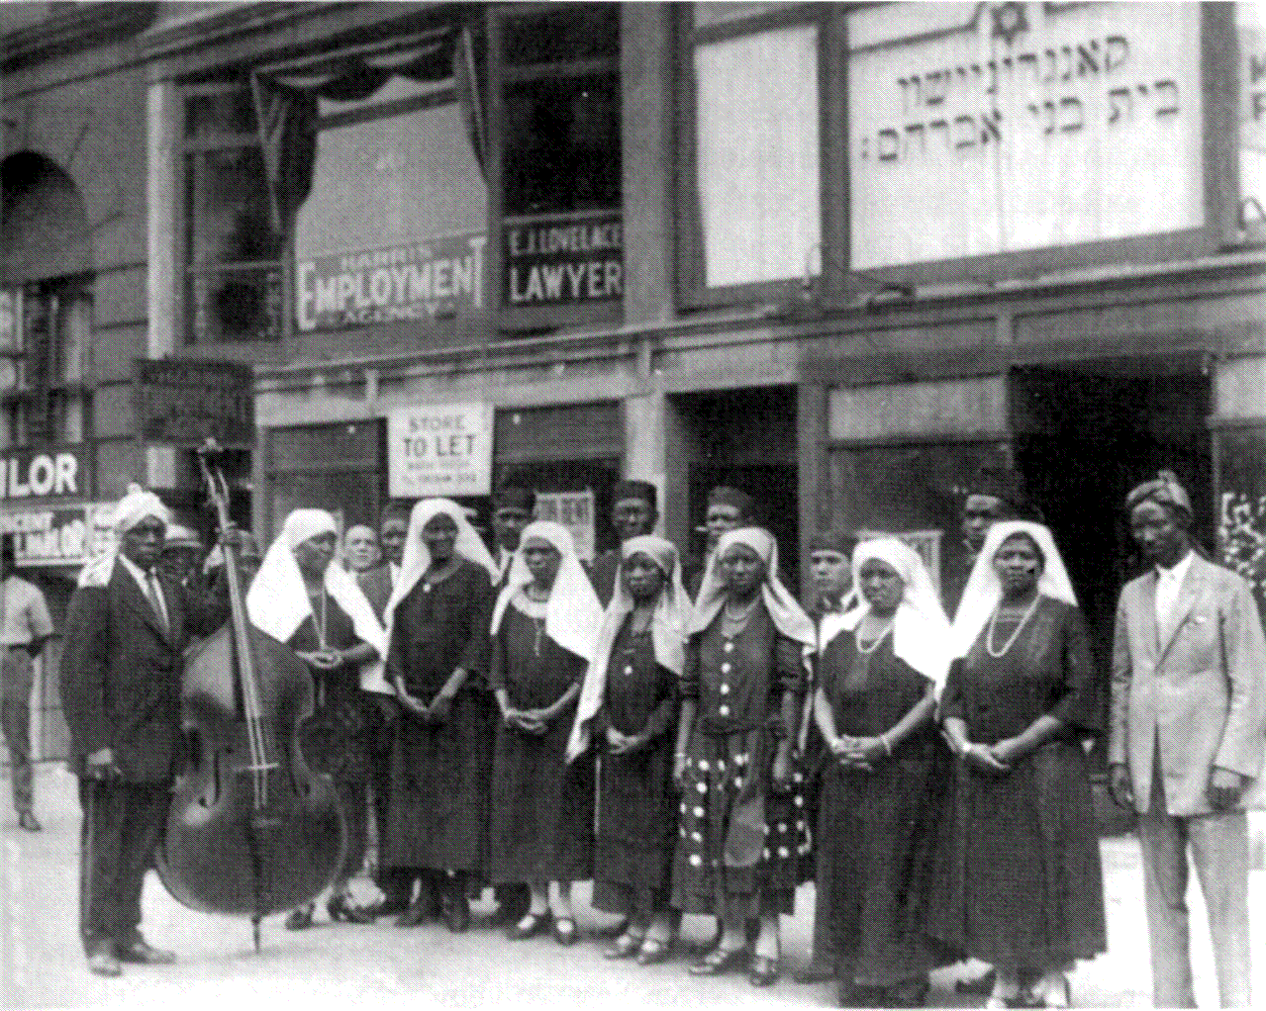
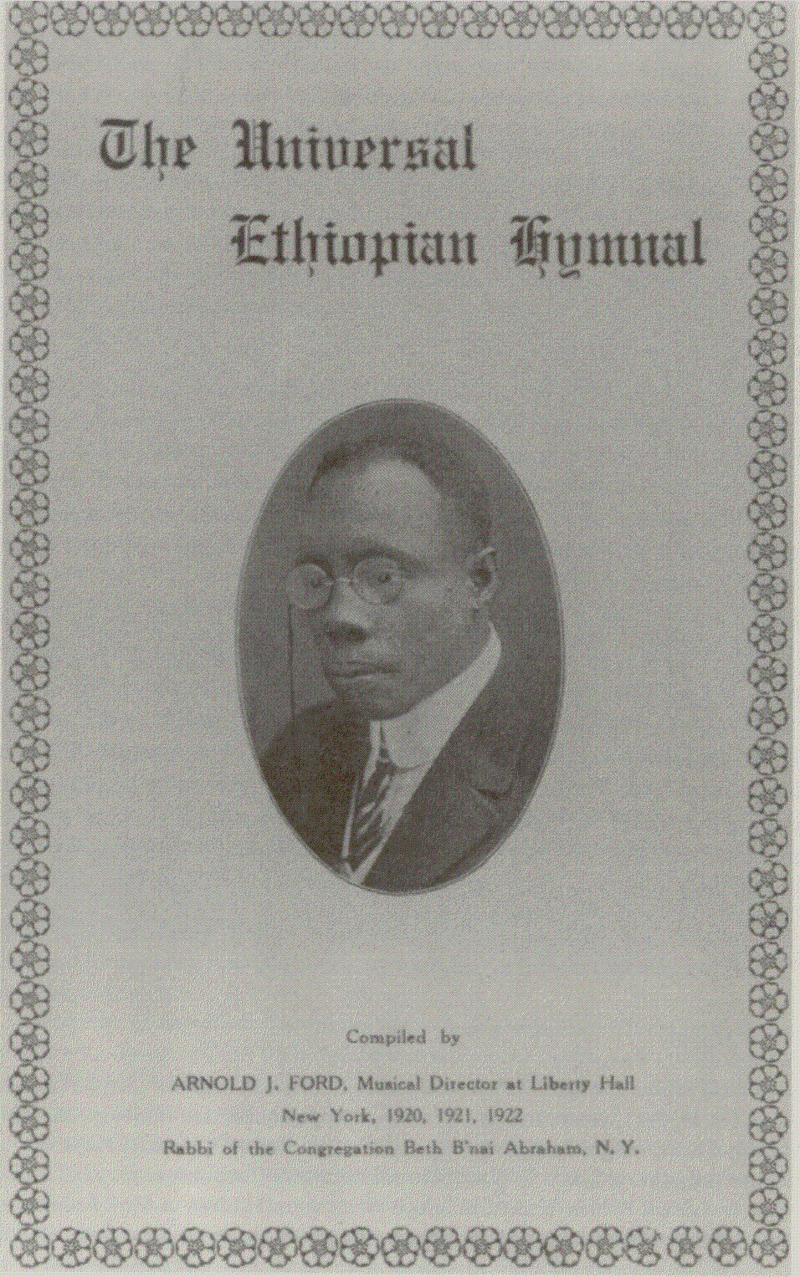
Rabbi Ford’s Choir 1920s

Slide 6
Intellectual Underpinnings
Slavery Created Cultural and Social Dislocation
Racial Identity Alone Was Inherently Inferior; i.e. Negroness is insufficient.
True Identity Must Be Found To Gain Equality

Slide 7
Theological Influences
Slaves Converted to Christianity 1740s
Strong Affinity to the Old Testament
Identification with the Hebrew Slaves
Prominence of Judaic themes in Negro Spirituals
Very Thorough Knowledge of Biblical Judaism

Slide 8
Scriptural Support
Deuteronomy Chapter 28
Jeremiah 29:14
Ezekiel 11:17, 20:34, 20:41, 36:24
Zephaniah 3:20
Isaiah 11:11-12
Dispersal of the Jewish People
Ten Lost Tribes

Slide 9
Biblical Horn and Trumpets
Ram’s Horn / Shofar
Ancient origins
Ram
Joshua blew these horns to bring down the walls of Jerico
Levitical / Priestly Trumpets
Moses
Made of silver
Used in the Holy Temple

Slide 10
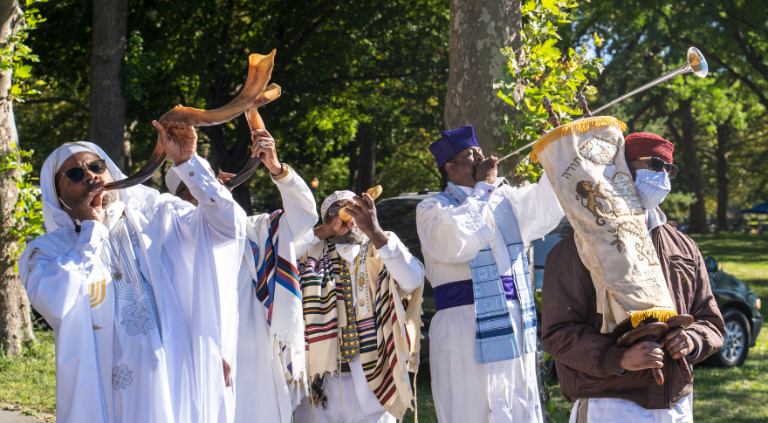
Yom Zikron / Day of Blowing “Jewish New Year”
Video Clip

Slide 11
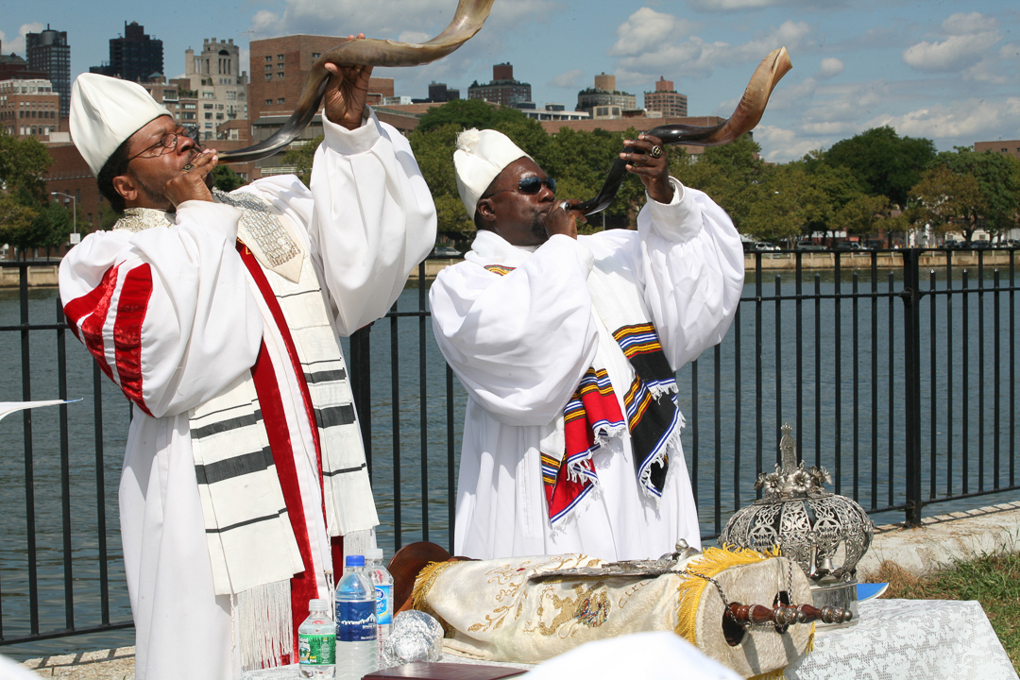
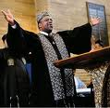
Psalm 150 “Praise the Lord with the Trumpet”
Chief Rabbi Capers Funnye, Chicago
Video Clip
Black Rabbis in New York welcoming the Jewish New Year

